Slide 1
AN ENVIRONMENTAL AND SUSTAINABILITY EDUCATION CENTER

Slide 2
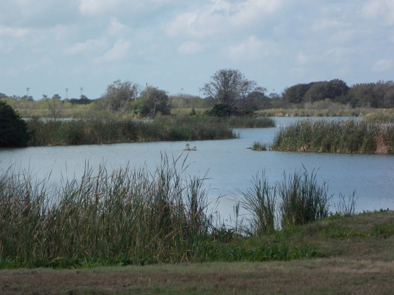
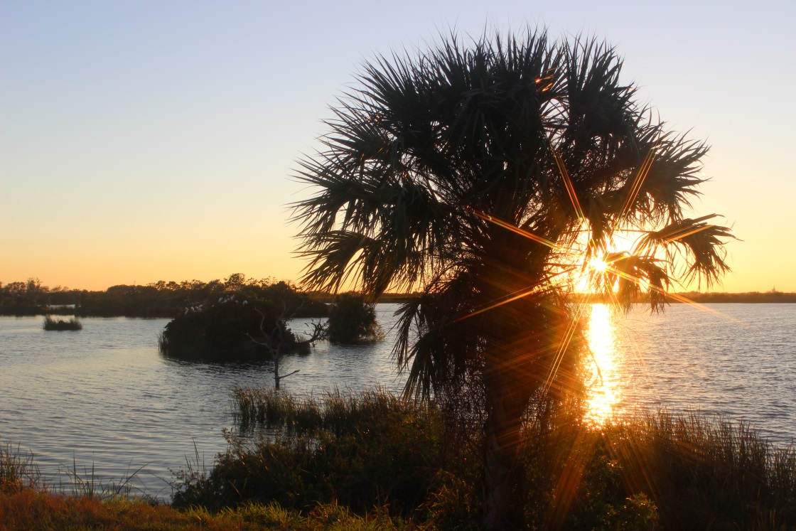
MERITS TO THE COMMUNITY
Contribution to the City’s Comprehensive Plan Recreational Requirements
Connects Recreational Areas
A Legacy of Reclamation, Environmental Stewardship and Sustainability

Slide 3
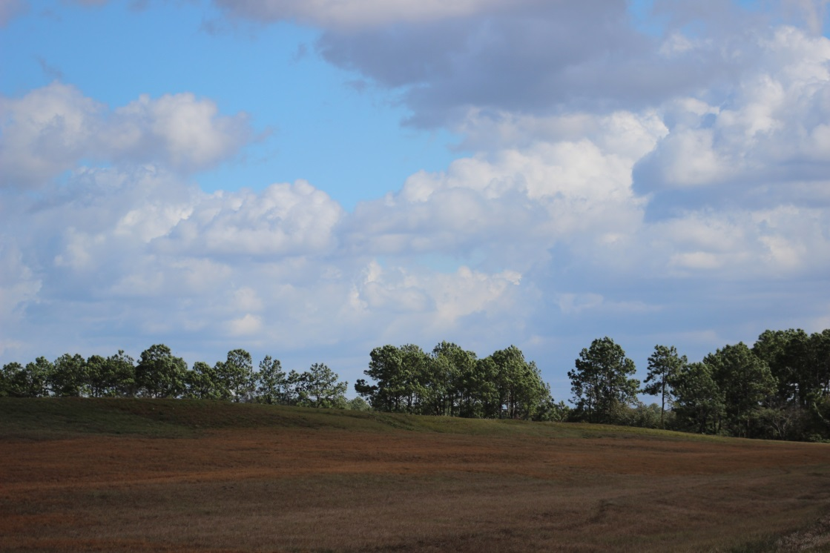
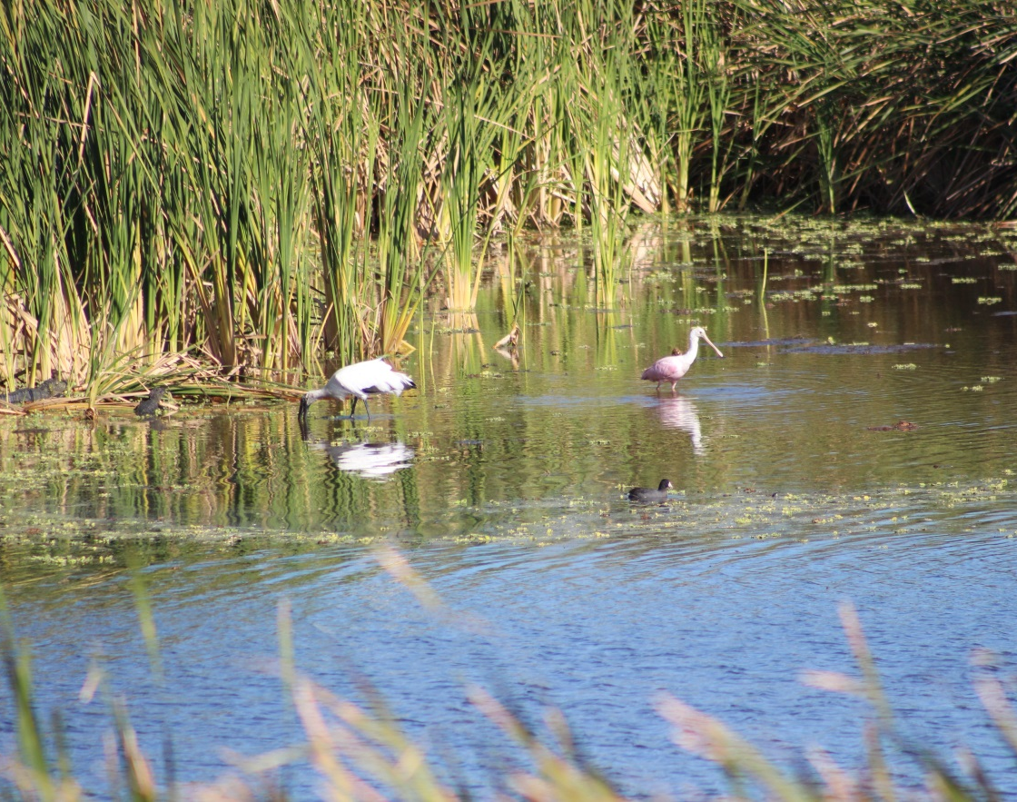
EXPANSION OF THE CITY’S RECREATIONAL LANDS
Se7en Wetlands addition to the City’s recreational lands will expand the City’s 1,400 acres of active recreation by 440 acres and will exceed any future comprehensive plan obligations

Slide 4
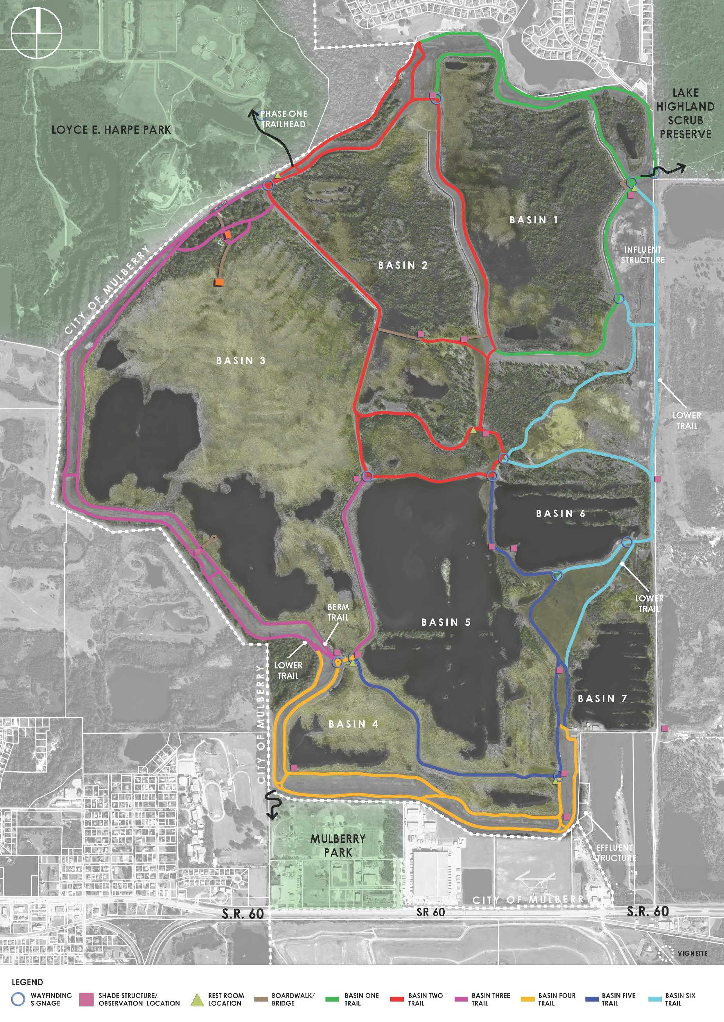
RECREATIONAL CONNECTIONS
Connecting 2,764 acres of environmental and recreational lands to:
Loyce E. Harpe Park (535 acres)
Lake Highland Scrub Preserve (551 acres)
Mulberry Park (38 acres)
Se7en Wetlands (1,640 acres)

Slide 5
RECLAMATION
1985; City of Lakeland purchases property reclaimed from phosphate mining
1987; City of Lakeland’s Wetlands Treatment System begins operating on the reclaimed land
The system provides a tertiary treatment for the City’s wastewater
In addition to providing water treatment, the site also provides a habitat for a vast variety of plant and animal species.

Slide 6
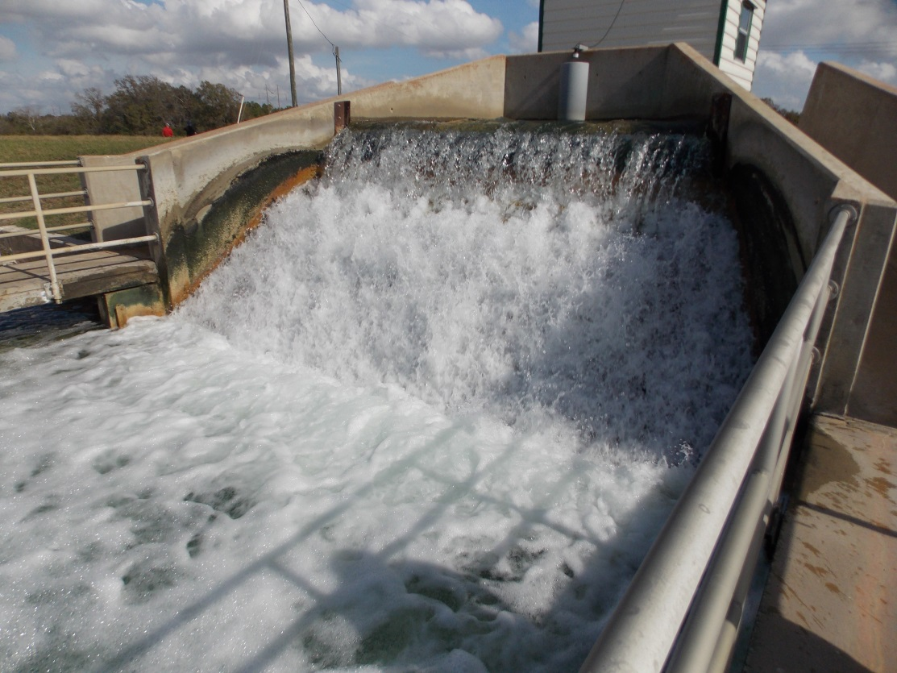
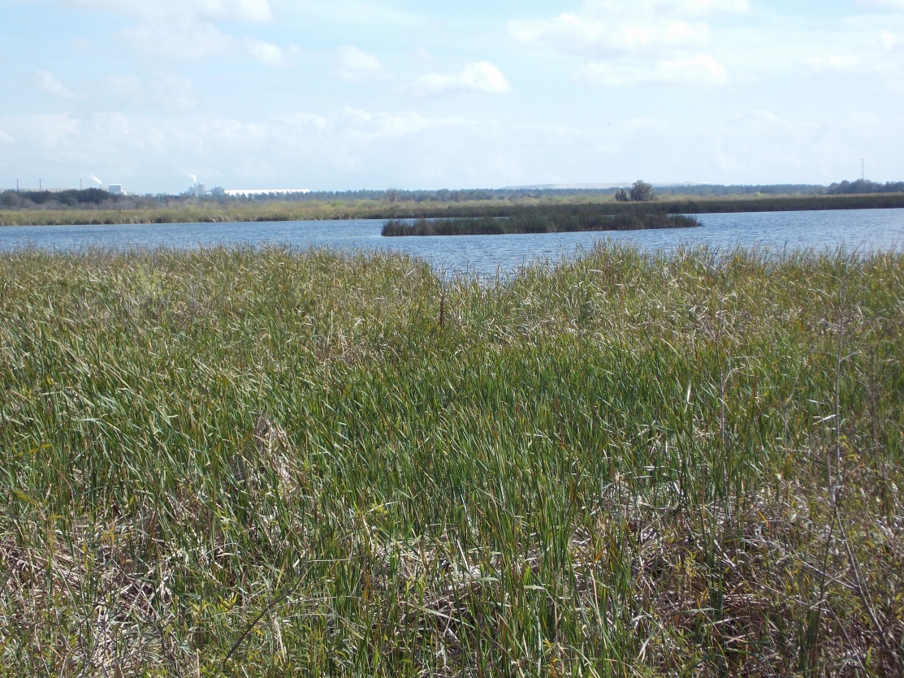
ENVIRONMENTAL STEWARDSHIP
Wastewater Treatment
Advanced Wastewater Treatment via the Wetland Treatment System prior to 100% reuse for City of Lakeland Wastewater
Reuse by Lakeland Electric (3-4m/day)
Reuse by TECO (7.5m/day)
Preservation of the property itself, providing wildlife habitat

Slide 7
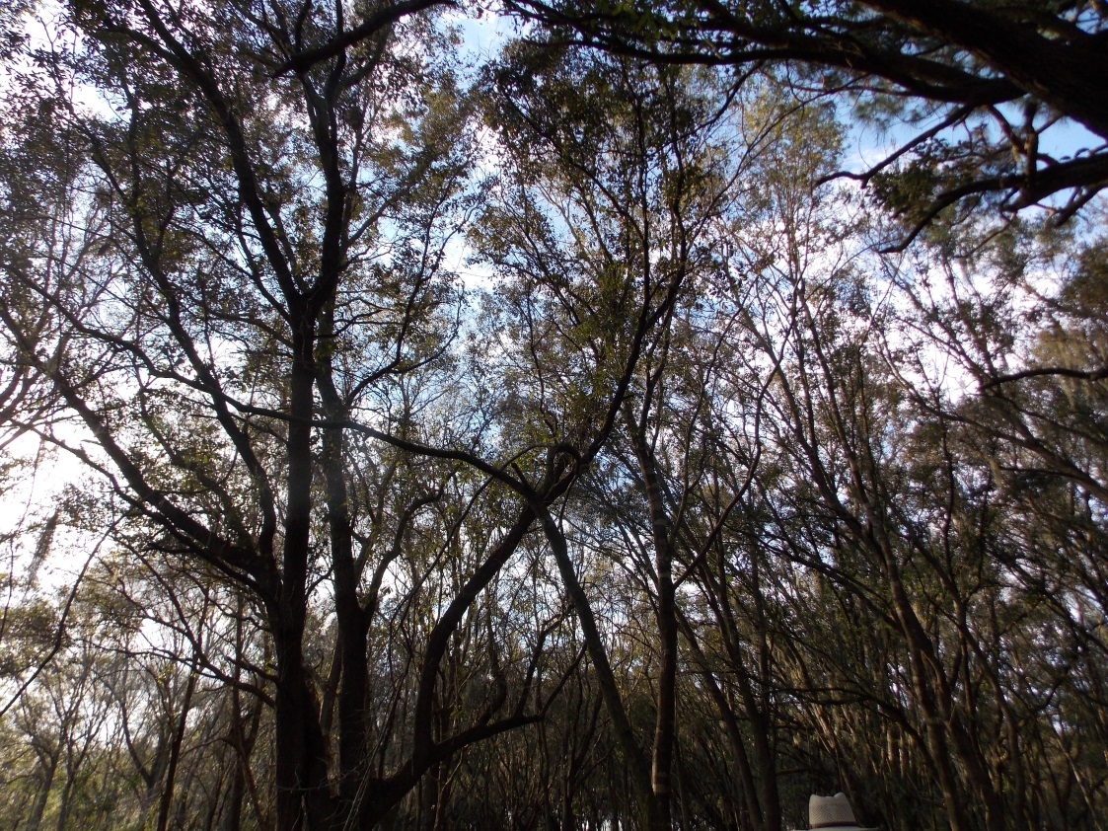
ENVIRONMENTAL STEWARDSHIP
Partnerships between Lakeland, Polk County, TECO and the SWFWMD for the redirection of treated wastewater to the TECO Polk Power Station
Reduces dependence on surface water disposal of treated water
Reduces groundwater use by TECO

Slide 8
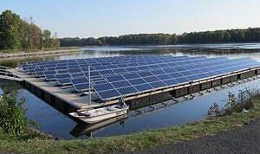
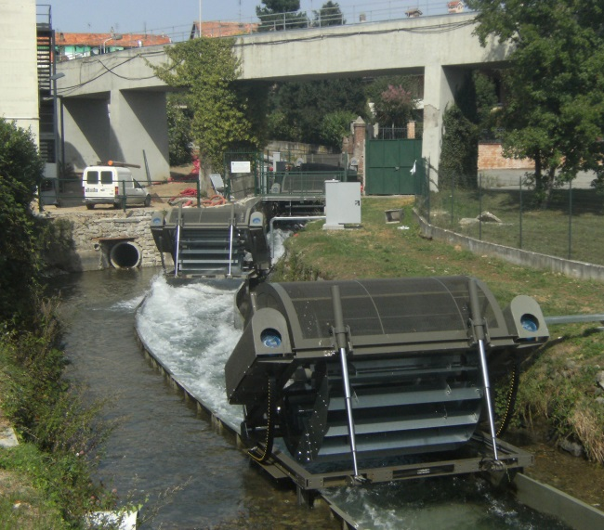
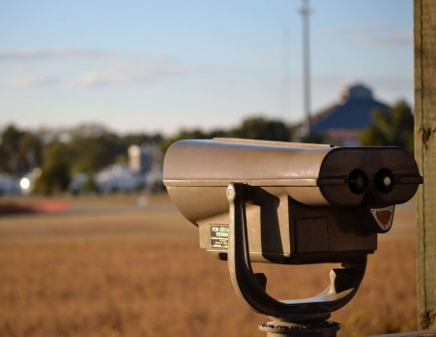
SUSTAINABILITY
Hydro Energy Generation at influent outfall
Solar Energy Generation from floating arrays in basin 7
Wind Powered Energy Generation from vertical wind turbines (wind foils) located at Basin 7
Water Reuse in the TECO Polk Power Station cooling system
Se7en Wetlands’ vast open spaces and operations provide an opportunity to install a variety of energy generating devices as demonstration projects and as potential sources of electricity for some or all of the site’s needs.

Slide 9
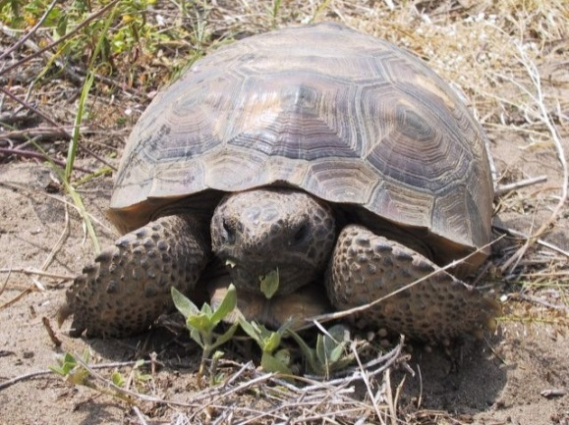
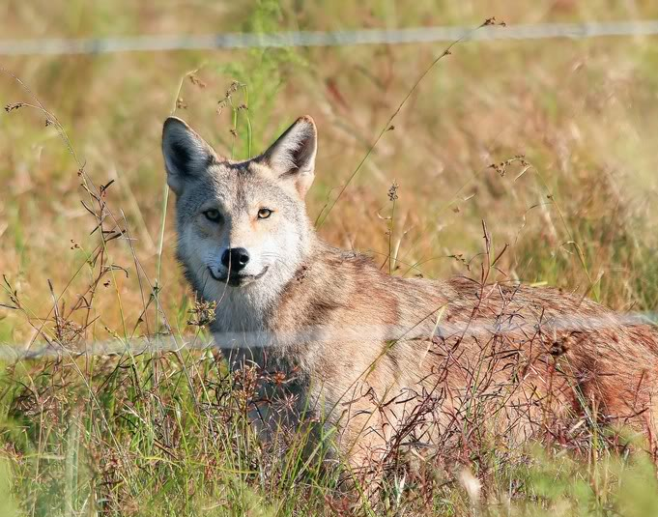
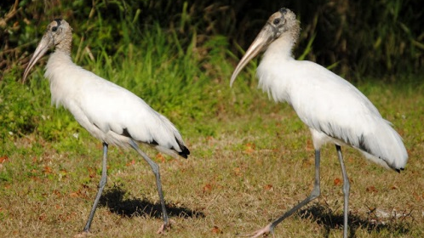
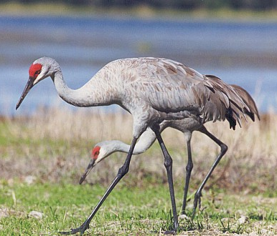
ENVIRONMENTAL EDUCATION
Wildlife
Alligators
Coyotes
Gopher Tortoises
Turtles
Fish
Existing Wetland Lab
Water Quality Analysis
Soils Analysis
Vegetation Studies
Environmental Center
Birding
Migratory Path
Permanent Bird Population
Water Quality Lab
Wildlife Observation
Birding
Wood Storks
Sand Hill Cranes
Eagles
Ospreys
Hawks

Slide 10
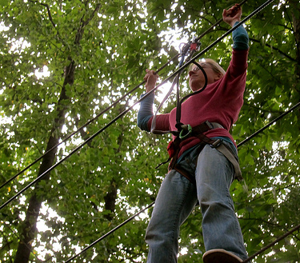
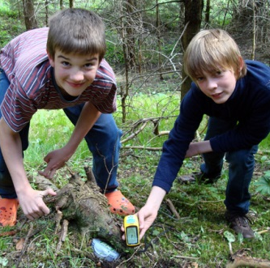
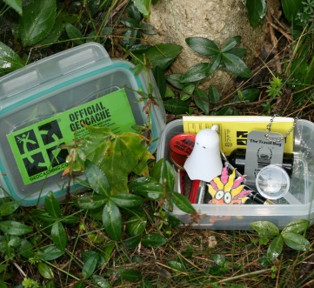
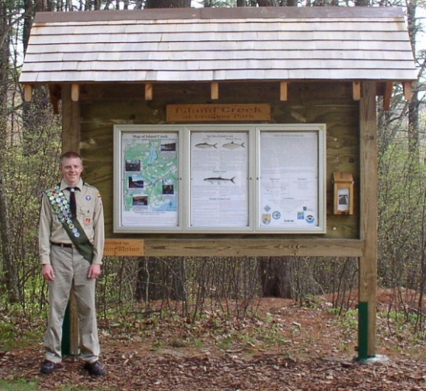
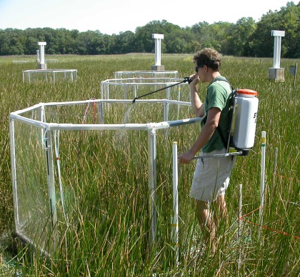
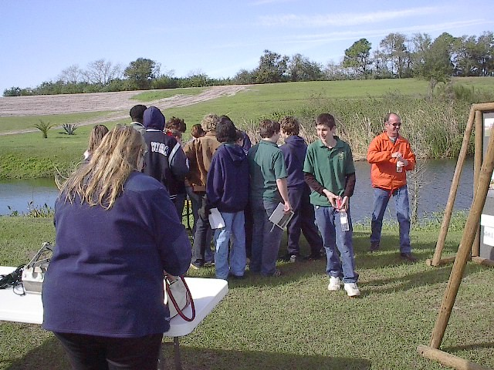
VISITORS/USERS
Groups (Leadership, Environmental, Governmental, Educational)
Geocaching
Home Schoolers
Summer Camp Programs
Special Events
Cross Country
Adventure Course
Eagle Scout Projects
Professional/Graduate Research
Ecotourism
Utility Demonstration Projects
Outdoor Wildlife Photography/Painting
Night Programs
Wildlife
Stargazing
Resident Artists/Guest Artists

Slide 11
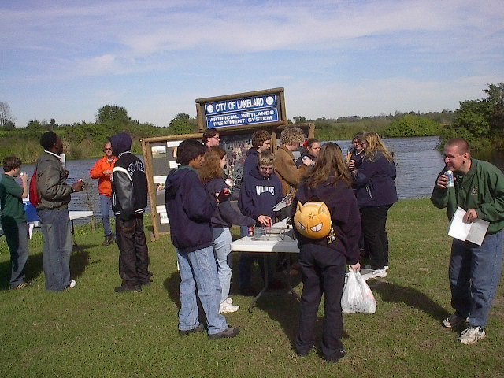
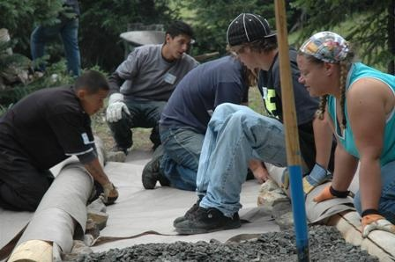
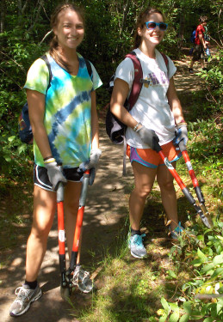
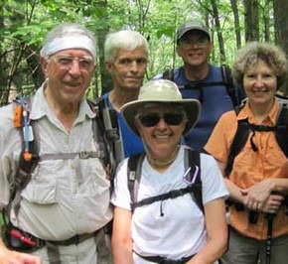
INDICATORS OF SUCCESS
Awareness in the Community
Return Visitations
Quantity of Wildlife Sightings
Internet Likes
Sponsorships/Donations to Cover Maintenance
Development of a Successful “Friends” Program
Diversity of Users (ages, interest, socioeconomic)
A Destination/Attraction
Established Partnerships
Connection to Statewide Trail System
Photo Postings Online

Slide 12
FEATURE AREA
“A” Education Enter
“B” Phase One Parking and Entry
“C” Influent Interpretive Site
“D” Se7en Wetlands Overlook Tower
“E” Rookery Overlook
“F” Sustainability/ Alternative Energy Overlook
“G” Tree Ring/ Observation Deck

Slide 13
FEATURE AREA
EDUCATION CENTER
Interpretive/Visitors Center (+/- 3,100 SF)
Outdoor Classroom & Observation Deck (+/- 1,000 SF)
Suspension Bridge
Understory Orientation Classroom
Boardwalks, paved pathways and unpaved pathways
Bus Parking

Slide 14
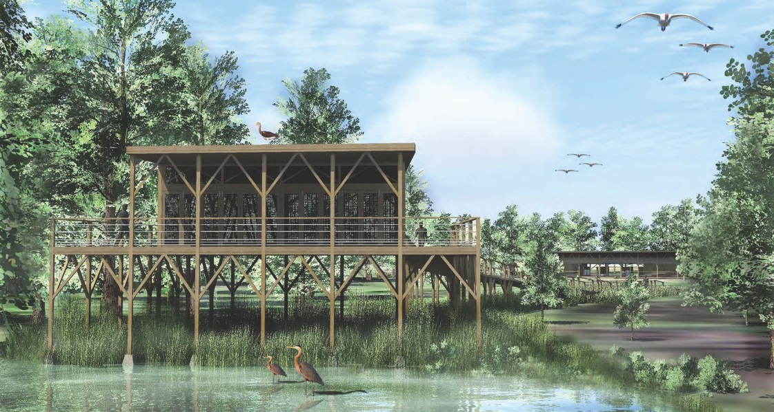
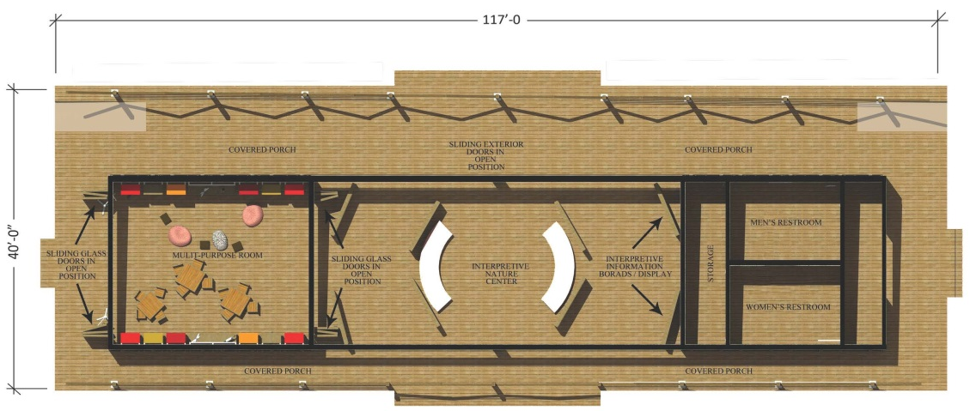
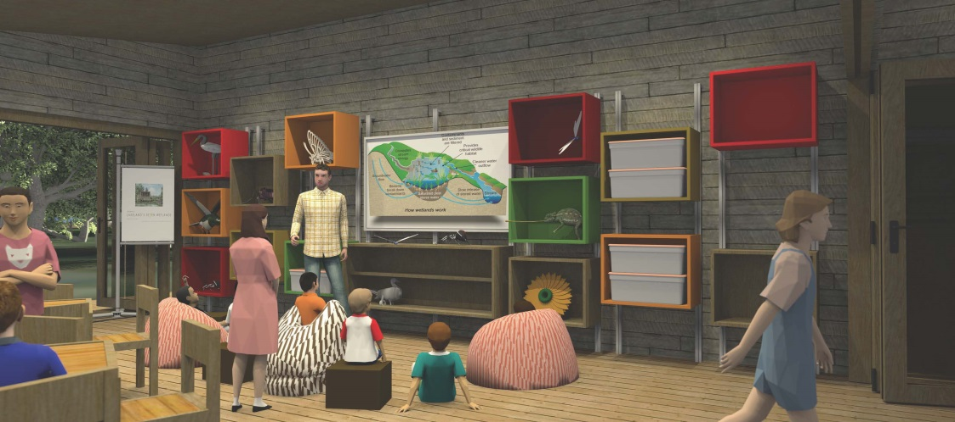
FEATURE AREA
EDUCATION CENTER
“Dogtrot or Breezeway House” Design.
Informal classroom space with restroom facilities and storage.
Open air center area of building.
Harmonious blend to natural surroundings utilizing natural materials.

Slide 15
FEATURE AREA
EDUCATION CENTER
Children’s Interactive Model
Water treatment basin flow with windmill driven pump that circulates water
Meadow Classroom
Central speaking platform and fire pit

Slide 16
FEATURE AREA
PHASE 1 PARKING & ENTRY
Interpretative Signage
Drinking Fountain, Benches and Trash Receptacles
Existing Bike Path
Rest Room Facility
Walking Path and ramp to Basins 2 and 3

Slide 17
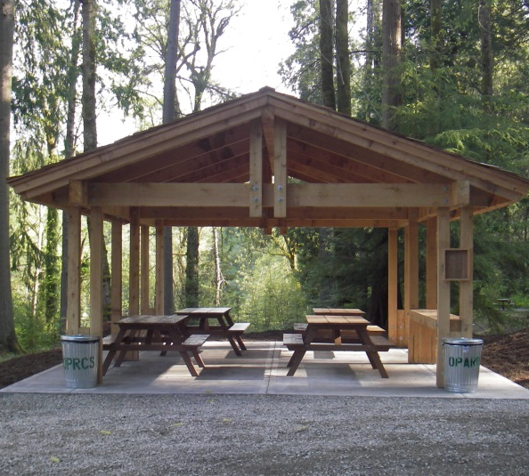
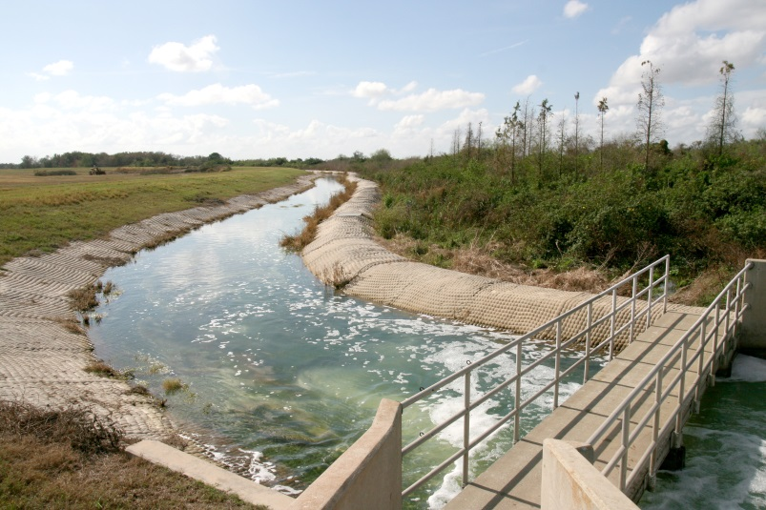
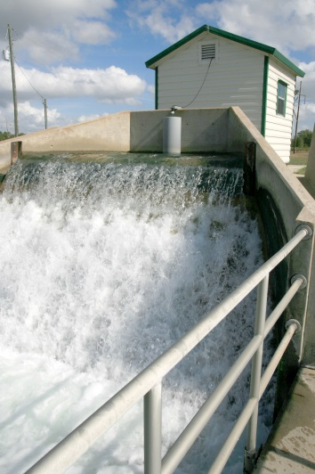
FEATURE AREA
INFLUENT INTERPRETIVE SITE
Boardwalk and Shaded Observation Deck
Restroom/Group Pavilion
Interpretive Signage
Hydro Energy Generation
Locational ID Vertical Wind Turbine (Wind Foils)

Slide 18
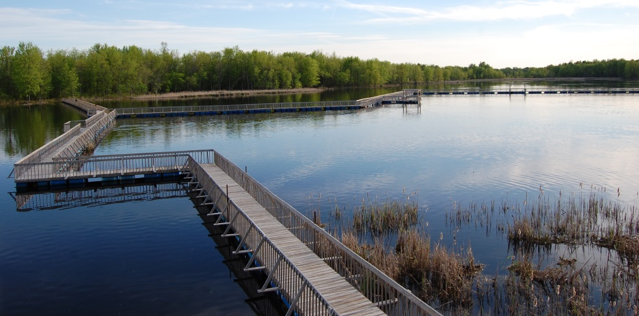
FEATURE AREA
BASIN 2 OVERLOOK
Observation Tower
ADA Boardwalk to Basin 1 Levee
Floating Boardwalk
Binoculars
Interpretive Signage

Slide 19
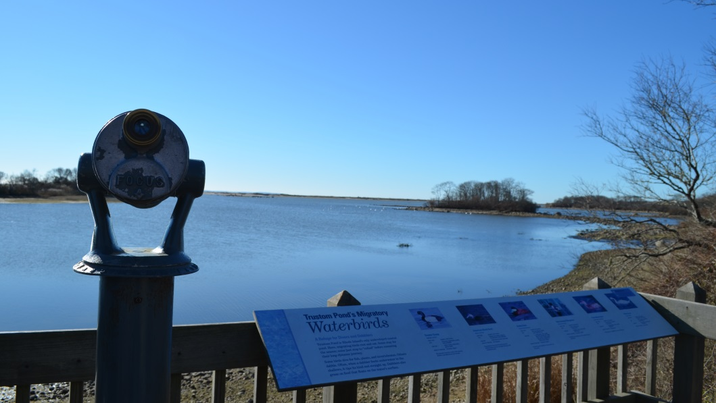
FEATURE AREA
ROOKERY OVERLOOKS
Shade Structure
Binoculars
Interpretive Signage

Slide 20
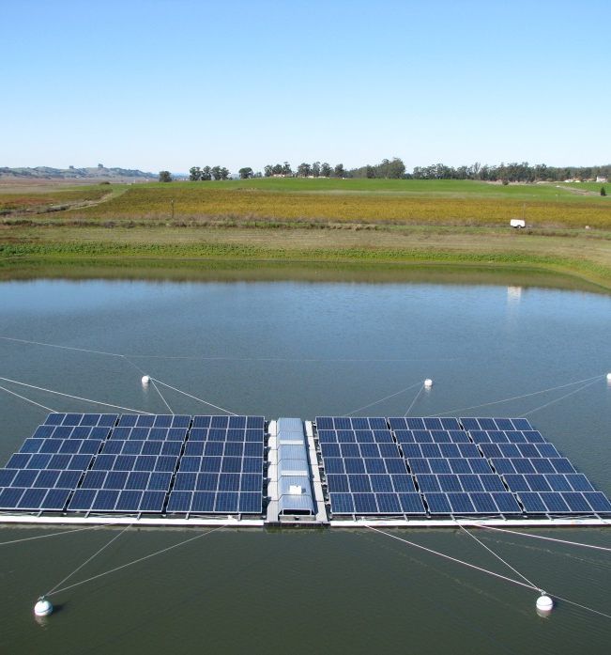
FEATURE AREA
SUSTAINABILITY/ALTERNATIVE ENERGY
Solar Power Array
Wind Turbine
Observation Pavilion
Binoculars
Interpretive Signage

Slide 21
FEATURE AREA
TREE RING/OBSERVATION DECK
Observation Deck around Existing Live Oak
Floating Boardwalk
Binoculars
Basin Sight Rings
Interpretive Signage

Slide 22
IMPLEMENTATION
PHASE ONE
Phase One, Upper Trail
Basin One (1.7 miles)
Basin Two (2.9 miles)
Phase One, Lower Trail
Basin One (1 mile)
Basin Two (.8 mile)

Slide 23
IMPLEMENTATION
UPPER TRAIL/BERM SYSTEM
Phase One
Basin One (1.7 miles)
Basin Two (2.9 miles)
Phase Two
Basin Three and Education Center Campus and Trailhead (3.6 miles)
Phase Three
Basin Five and Seven (2.7 miles)
Phase Four
Basin Four (1.3 miles)
Phase Five
Basin Six and Basin 2 Trail (.9 mile)

Slide 24
IMPLEMENTATION
LOWER TRAIL SYSTEM
Phase One
Basin One (1 mile)
Basin Two (.8 mile)
Phase Two
Basin Three and Education Center Campus and Trailhead (1.8 miles)
Phase Three
Basin Five and Seven (.9 mile)
Phase Four
Basin Four (1.37 miles)
Phase Five
Basin Six (1.57 miles)

Slide 25
WAYFINDING
EXISTING:
LOYCE E. HARPE PARK/CARTER ROAD ENTRY SIGN
Complements the existing Polk County’s Loyce E. Harpe Park
Same material and color with Se7en Wetlands brand logo, official name, and City of Lakeland logo
PROPOSED:

Slide 26
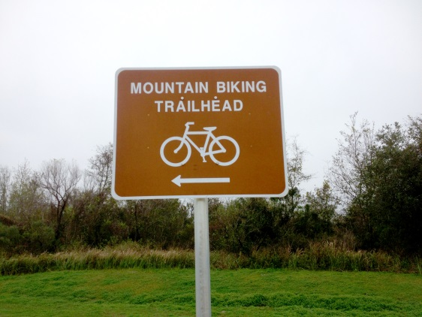
WAYFINDING
EXISTING:
DIRECTIONAL SIGNAGE
Complements the existing directional signage within Loyce E. Harpe Park
Directional arrows and supporting symbols for user amenities/activities
PROPOSED:

Slide 27
WAYFINDING
Trail Blazer
Located along the trails and trail intersections for directional assistance
Cap includes a location or GPS coordinate and emergency assistance number for emergency responders
Galvanized steel plates with colors complementing trail colors with trail numbers

Slide 28
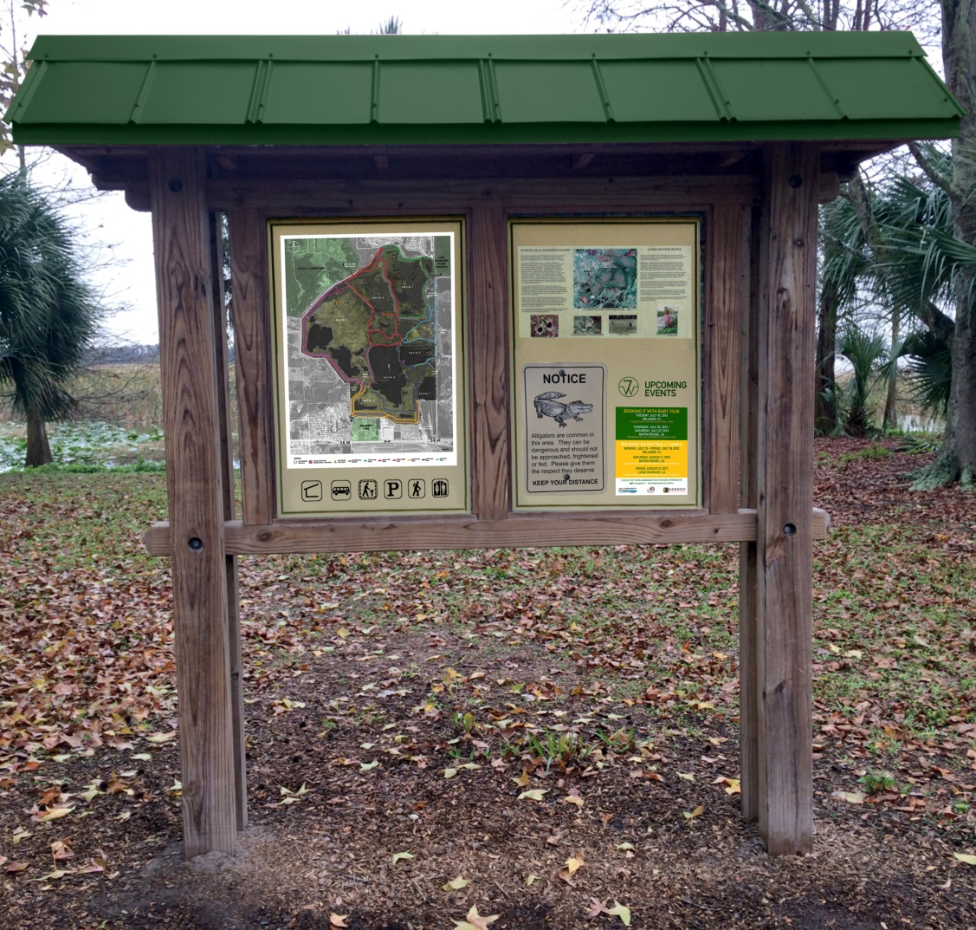
WAYFINDING
Wayfinding Kiosk
Located at strategic trail intersections
Provides directional location information, amenities provided, site information, updates on events and caution signs for animals
Designed to following existing directional and entry signage for a seamless transition
PROPOSED:

Slide 29
AN ENVIRONMENTAL AND SUSTAINABILITY EDUCATION CENTER THANK YOU

