Slide 1
BROADBAND COMMUNITY FORUM
October 1, 2019

Slide 2
Background
City operates over 330 miles of fiber
Fiber used by Polk County Schools, local libraries, public safety and substation monitoring
City leases fiber to local businesses like Lakeland Regional Health and other large users that require ultra-high-speed internet
Is there a desire to leverage the City’s fiber backbone and develop residential broadband services?
Notes:
The City owns and operates over 330 miles of fiber.
Fiber was originally installed so field workers could communicate with office operations.
Even though this Public-owned asset is used primarily for City operations we do lease dark fiber to some businesses like Lakeland Regional Health and other users that require ultra high speed internet.
The City’s fiber is also used by Polk County Schools, the libraries, our public safety entities and utility operations.

Slide 3
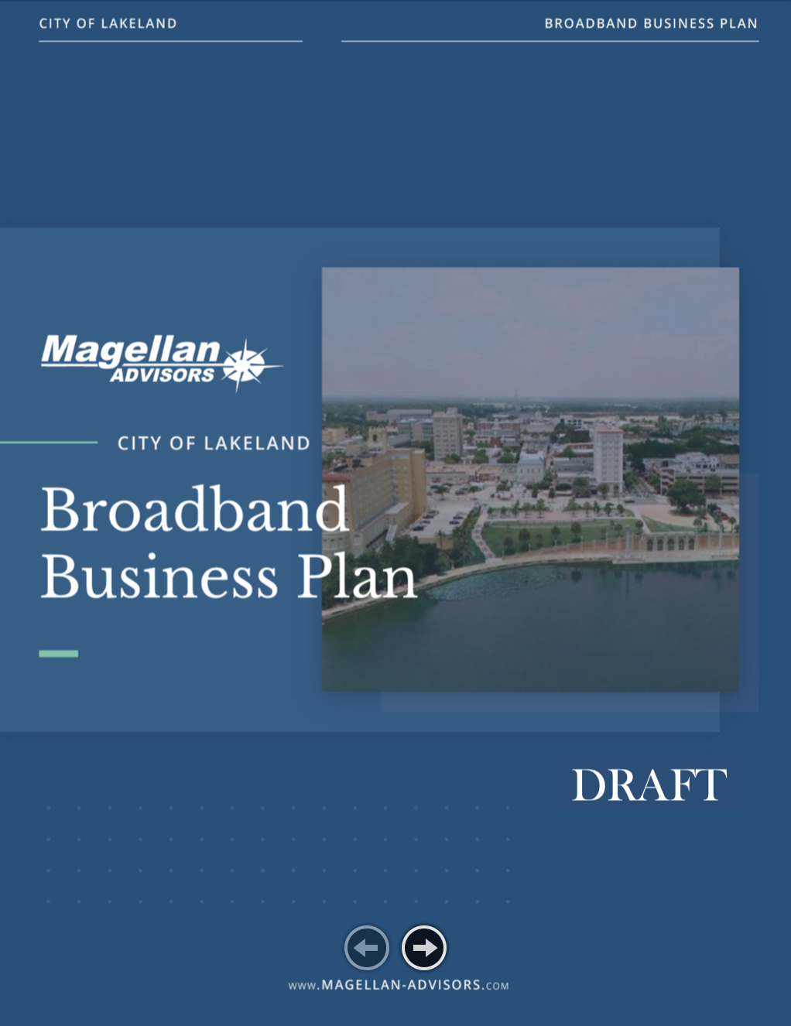
Magellan Advisors
First project was to develop the Lakeland Strategic Broadband Plan
Contract signed in May 2015
Final published plan July 2016
Broadband Business Plan
Contract signed November 2018
Final plan published September 2019
Notes:
The City of Lakeland has been talking about leveraging our fiber asset for a while. In 2015, the City of Lakeland signed a contract with Magellan Advisors, one of the nation’s leading broadband and information technology consultants to assist us with a Strategic Broadband Plan. The final plan was delivered and published summer of 2016. Magellan collected data that formed a baseline to help the Commission decide on going forward with the development of a business plan.
In 2018, a contract was signed with Magellan to develop a Broadband Business Plan that looked at inventory, competition, business development and implementation. That final plan was recently delivered and published. You can find it and other deliverables at lakelandgov.net/broadband.

Slide 4
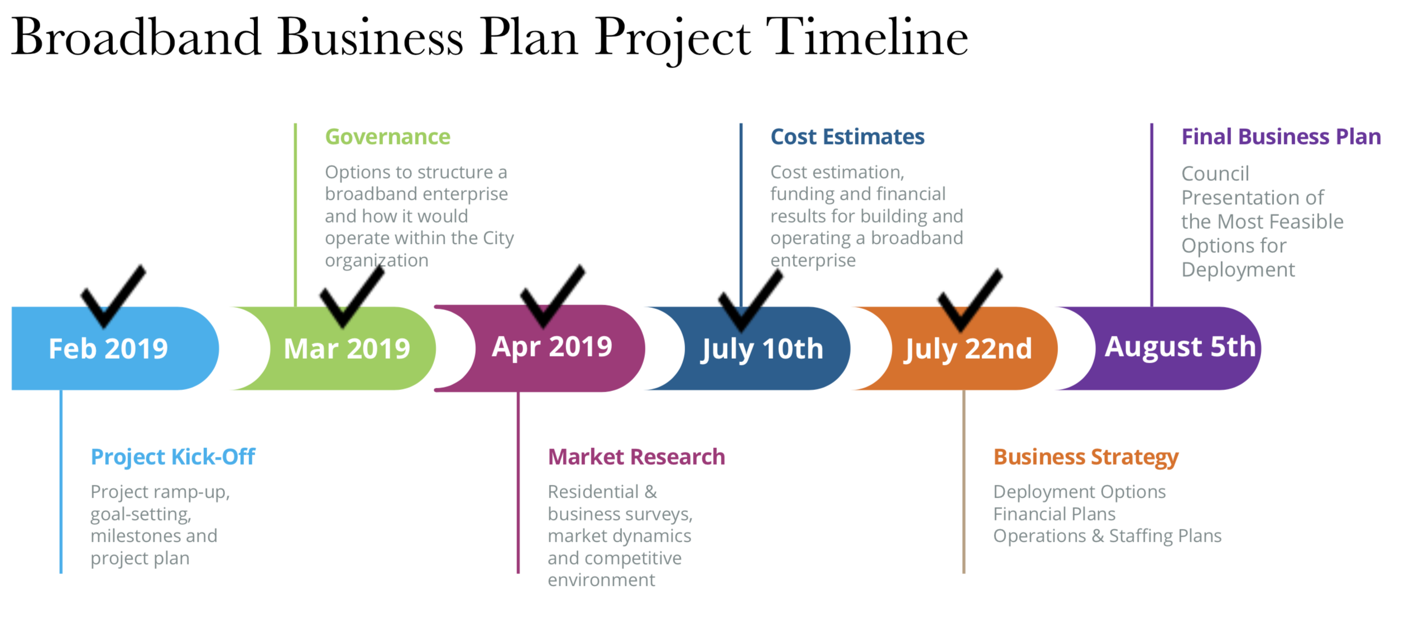
Notes:
The Business Plan kicked off in February and here is the timeline – as you can see there were monthly deliverables leading up to the finalization of the plan with critical market research that included residential & business surveys and a look at the competitive market.
Based on the market research, Magellan provided a roadmap that included cost estimates, pricing and deployment options.

Slide 5
Magellan Deliverables
Deployment Options
Key Assumptions
Services & Pricing
Financial Results
Implementation & Buildout Strategies
Notes:
We are going to expand on deployment options, key assumptions, pricing, financials and buildout strategies provided by Magellan in the Broadband Business Plan.

Slide 6
Notes:
Three buildout options were outlined. Fiberhoods where high-speed internet services would be built out based on a number of customers that signed up in a concentrated geographical area. This buildout strategy would take 3-5 years with a customer base of 20,000.
The second option is the City wide approach making the service available to all homes and businesses inside the Lakeland city limits with a possible customer base of 44,000 homes & businesses.
The third option includes Lakeland Electric’s service territory. This approach almost triples the customer base but it has additional costs because of needed infrastructure in rural areas. The City Commission opted to explore the Citywide deployment. This major assumption shaped cost and pricing in the Broadband Business Plan.

Slide 7
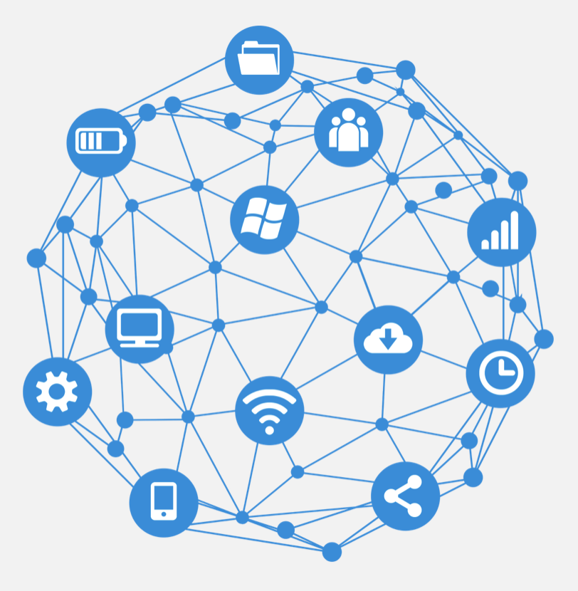
Key Assumptions
Deploy fiber to homes and businesses within the City limits = 44,000 total premises
Offer bundled packages with Internet, television and telephone services
38% residential, 41% commercial take rate
Two-year build-out before first service is available
Pricing levels based on creating the most competitive packages at the lowest rates
Financing and capital investment based on build out with operating reserves
Notes:
It is very important to note that the Business Plan is based on Key Assumptions. There are impacts if these assumptions are not met. The plan targets the 44,000 homes and businesses inside the Lakeland City Limits.
The plan includes bundled packages with internet, phone and television services. Another key assumption is based on take rate or the number of customers that would sign up for broadband service if the City were to offer it. Magellan Advisors based cost and pricing on a 38% residential and 41% commercial take rate along with a two year build out before the first customer would receive service.
Pricing is based on creating competitive packages at the lowest rate and the capital investment includes operating reserves.

Slide 8
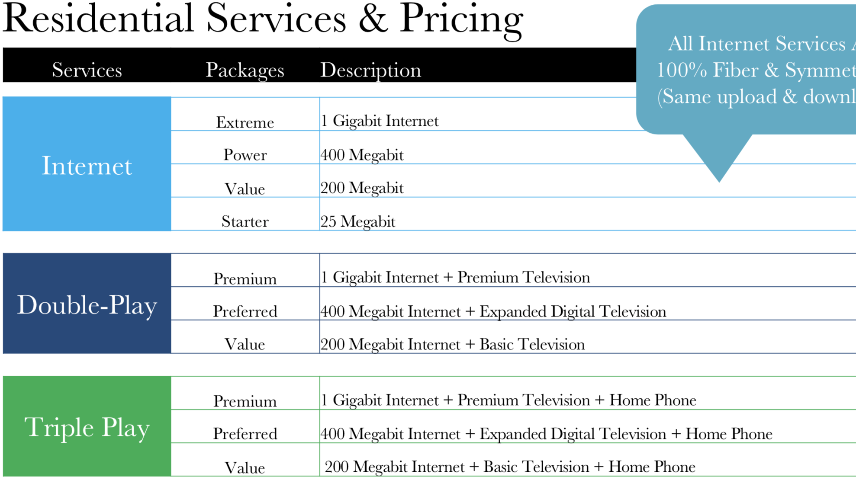
100% Fiber Connection -
Symmetrical with same upload and download speeds!
Notes:
Residential Pricing includes bundled service with 100% fiber connection. Internet services would range between an economical 25 megabits per second to gigabit per second speed.
For those that don’t know, a gigabit equals 1,000 megabits - VERY FAST. We will look at Residential Service and pricing a little closer.

Slide 9
Proposed Pricing*
Residential Internet
1 Gigabit $99.99
400 Megabit $59.99
200 Megabit $49.99
25 Megabit $19.99
*Does not include fees & taxes
Notes:
Based on market research and the Key Assumptions including the 38% residential take rate, the Magellan Broadband Business plan outlines internet pricing with a starting price of $19.99 and moving up to gigabit service for $99.99.
Please keep in mind that this is for service only and does not include fees and taxes. State and Federal agencies always get their share.

Slide 10
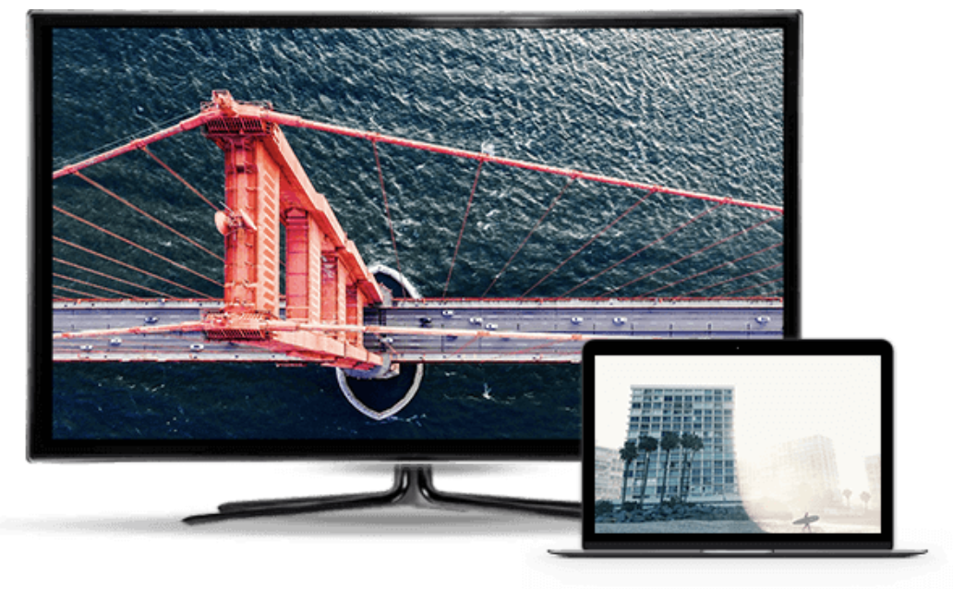
Proposed Pricing*
Residential Double Play
1 Gigabit + Premium TV $164.99
400 Megabit + Expanded TV $134.99
200 Megabit + Basic TV $ 74.99
*Does not include fees & taxes
Notes:
Double Play pricing includes internet service and TV. Proposed pricing on residential double play starts at $74.99 with basic TV and 200 megabit internet service.
Pricing goes up based on expanded television channels and increased internet speeds. The top tier double play package includes gigabit internet service and premium television at $164.99.
Again, this proposed pricing does not include taxes and fees.

Slide 11
Proposed Pricing*
Residential Triple Play
1 Gigabit + Premium TV + Phone $199.99
400 Megabit + Expanded TV + Phone $174.99
200 Megabit + Basic TV + Phone $119.99
*Does not include fees & taxes
Notes:
Residential Triple Play includes internet, television and phone service. Proposed pricing starts at $119.99 for 200 megabit service, basic television and phone.
A mid-tier option includes 400 megabit internet service, expanded television and phone for $174.99. A Premium Tier includes gigabit internet, premium television and phone service at $199.99.
Once again, these prices do not include fees or taxes and the pricing is based on the key assumptions we outlined earlier.

Slide 12
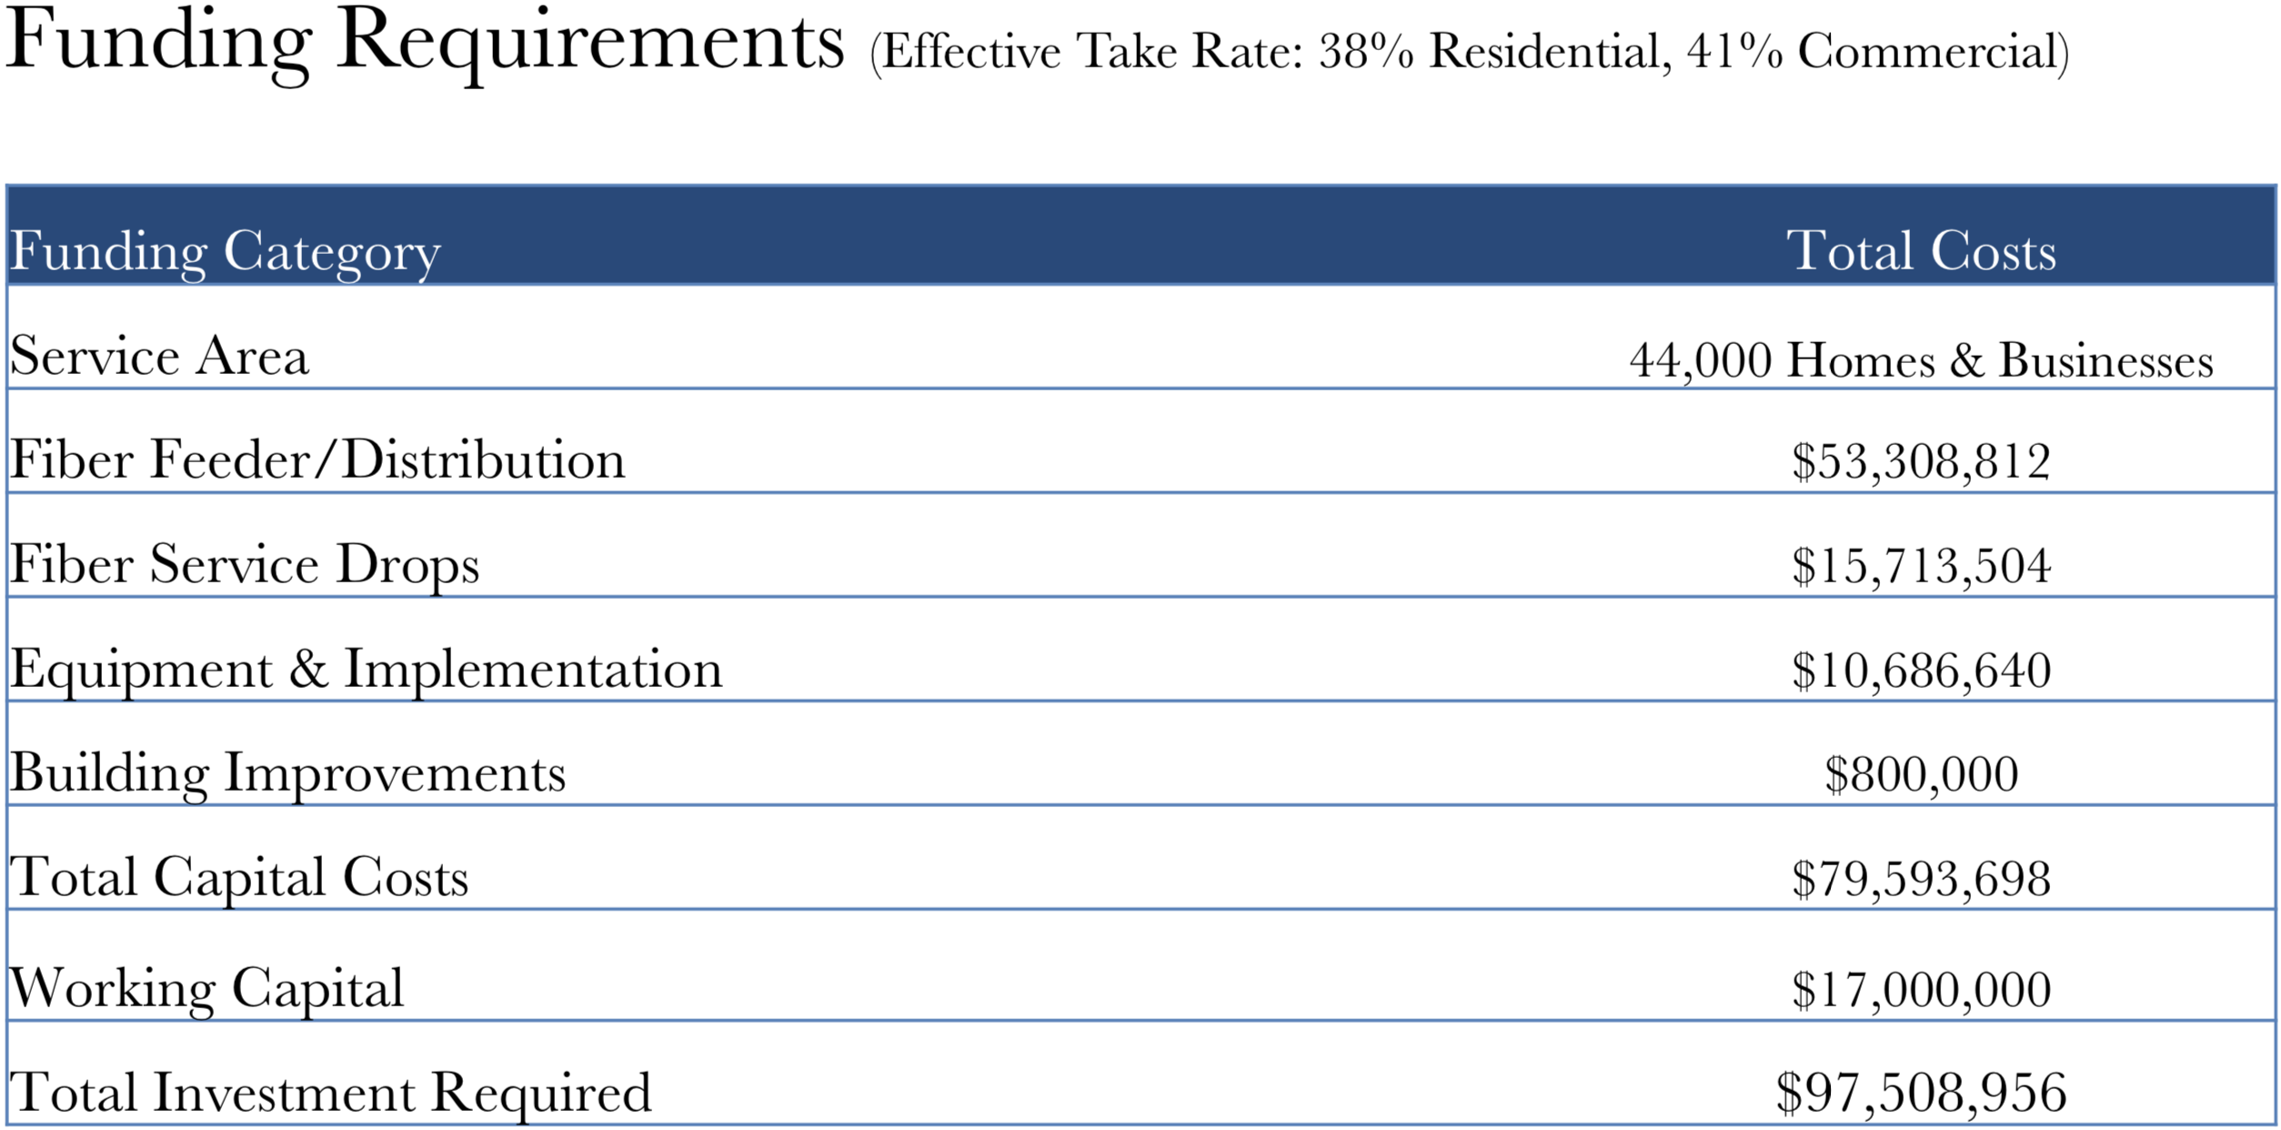
Notes:
Funding Requirements are based on the key assumptions that includes the 38% residential and 41% commercial take rate. Even though the City already has over 300 miles of fiber installed, the real cost is what is known as the last mile and that is connecting customers to the existing fiber back bone.
$79.5 Million in capital is needed – this includes fiber distribution, service drops to homes and businesses, equipment and building improvements. The plan also calls for $17 Million in working capital so the business can get off the ground.
This totals a little over $97.5 million that would be required if the City were to move forward with offering high speed internet service to our Lakeland residents and businesses.

Slide 13
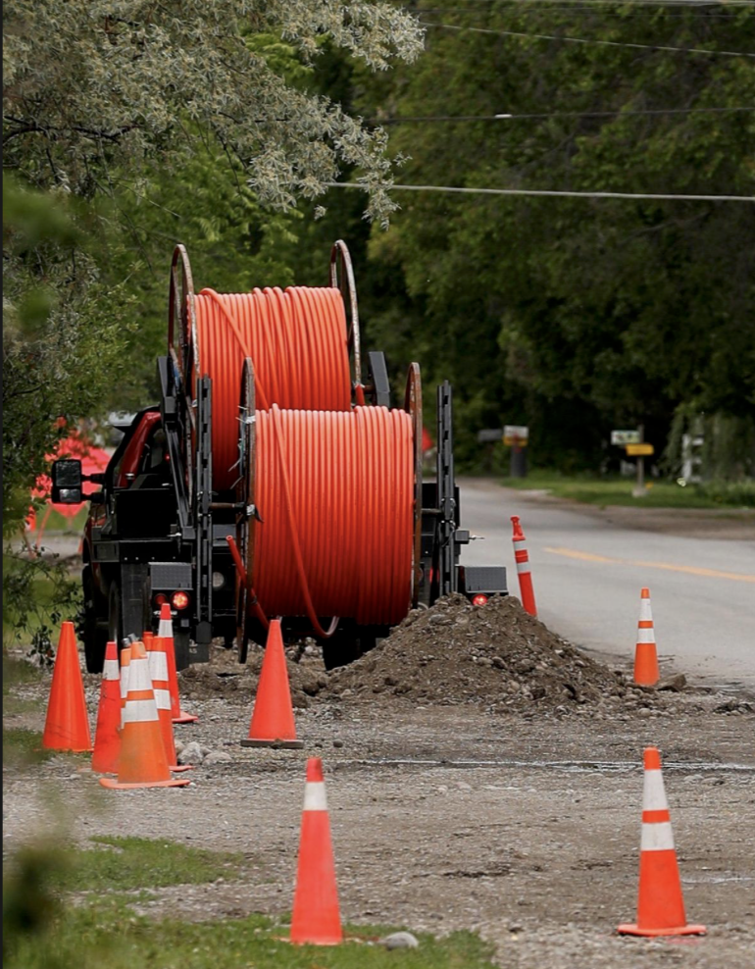
Implementation
Start with Engineering
1st Year – Phase One Construction
2nd Year – First Customers Connected
3rd & 4th Year – Phase Two Construction
5th & 6th Year – Phase Three Construction
7th & 8th Year – Future Phase Construction
Notes:
The Broadband Business Plan does outline a buildout schedule that would be done in phases with the first customers connected in the 2nd year of implementation.

Slide 14
Estimated
Break-Even Year 11
Notes:
Based on the $97.5 million funding requirement and the phased build out to reach all possible customers, there is an estimated break even point at year 11.
If the first phase of customers come online in 2021 and everything goes according to plan, the City is estimated to turn a profit in 2031 with $10.6 Million.
Estimated profits fluctuate after that point between $10.5 Million and $11.1 Million. Again these are estimated figures based on the assumed take rate, competition and the implementation schedule.

Slide 15
Impact of Take Rates on Annual Revenues
 | 20% | 25% | 30% | 35% | 38% | 40% | 45% | 50%
Estimated Annual Revenues (millions) | $(3.3)M | $(1.2)M | $ 1.9M | $ 4.6M | $ 6.7M | $ 7.2M | $ 9.9M | $ 12.6M
Impact of Price Changes on Annual Revenues (Assumes 38% Take Rate)
 |  | -30% | -20% | -10% | 0% | 10% | 20% | 30%
Estimated Annual Revenues (millions) |  | $(2.5)M | $ - | $ 3.7M | $ 6.7M | $ 9.2M | $ 11.9M | $ 14.7M
Notes:
So what happens if the assumed take rate doesn’t happen? This slide shows the impact of take rates and what happens to annual revenues if the take rate is lower or higher than the assumed 38% for residential customers.
If the take rate is below 25%, we will be losing money as you can see here. At a 25% take rate the program would lose $1.2 Million per year. At at 20% take rate, the losses are even greater.
The second portion of this chart shows the impact of pricing at the 38% residential take rate. For example if prices are lowered 20% under proposed levels to get the 38% take rate, there is zero revenues. On the other hand if prices are raised 20% over what was proposed, profits jump by $3 million.

Slide 16
Possible Funding Alternatives
Millage increase (Taxes)
If allowable per State Statute, a millage increase might be used to pay for the required working capital of $17M
The principal and interest payments on the $17M could be financed between 5 – 10 years, which would allow for a sunset of that millage increase
The principal and interest payments on the additional $80M required for the project would be paid in the first few years from the $17M in working capital. Once the take rate gets high enough, those payments would come from the broadband revenues
Notes:
We all want faster internet but how do you pay for it? One ways is a millage increase. We are still reviewing the legalities but if it is allowed by State Statute, a millage increase could be imposed to cover the $17 Million.
The principal and interest payments on the $17 Million could be financed between 5-10 years and that would allow the millage increase to sunset or go-a-way.
The principal and interest payments on the additional $80 Million required for the project would be paid in the first few years from the $17 Million in working capital. Once the take-rate gets high enough, those payments would come from broadband revenues.

Slide 17
Notes:
What does a possible millage increase look like? If the City borrowed $17 Million and used a millage increase to pay this back with debt service over five years we are looking at a possible .5752 millage increase. This would raise property taxes from the current 5.4644 mills to 6.0396 mills over five years with a possible sunset.
If the City borrowed the $17 Million and used a millage increase to pay this back with debt service over 10 years, we are looking at at .3145 millage increase. This would raise property taxes from 5.4644 mills to 5.7789 mills over a dedicated 10-year term with a possible sunset after the 10 years.

Slide 18
Possible Funding Alternatives (con’t)
Special Assessment
If a defined benefit is recognized for all homes and businesses within the City limits, a Special Assessment for the $17M Working Capital or for the entire $97M project may be possible
The estimated assessment on $17M for 44,000 businesses and homes would be approximately $386
The estimated assessment on $97M for 44,000 businesses and homes would be approximately $2,205
Notes:
Another possible funding source could be a special assessment.
If a defined benefit is recognized for all homes and businesses within the City limits, a Special Assessment for the $17 Million Working Capital or for the entire $97 Million needed for the project could be implemented.
The estimated assessment on $17 Million for 44,000 businesses and homes would be approximately $386. The estimated assessment on $97 Million for 44,000 businesses and homes would be approximately $2,205.

Slide 19
Proposed Benefits
Proposed Risks
Increased Internet Speeds
Reduced Cost to Consumer
Enhanced Economic Development
Reduced Lead Time for Services
Better Customer Service
Digital Divide Solutions
Support Smart City Initiatives
Opportunity to Support 5G
Possible City Revenue Source
Start up Cost = $97M
10-Year Breakeven Point
Possible Lawsuits
State & Federal Rulings
Buildout Cost Increases
Competition Tactics
Network Upgrade
Reduce Prices
Increase Internet Speeds
Lock Customer Contracts
Missed Assumptions
Notes:
There are definitely pros and cons associated with the development of a City Owned and Operated Broadband Utility. We have outlined a few obvious here as Proposed Benefits and Risks.
Benefits include increased internet speeds, current providers don’t have anything close to gigabit speed for residential customers and we are not sure if their current infrastructure would allow it.

Slide 20
Public Comment

